Slide 1
Physiological Assessment of Coronary Artery Disease
FFR/IFR
DR SURESH S
Senior resident
MCH CALICUT

Slide 2
Structure & Function of the Coronary circulation
Epicardial arteries (>400 μm in diameter)
  Serve a conduit artery function,
Coronary resistance
  Resistance arteries (100 to 400 μm),
  Arterioles (>100 μm),.
Capillary density
  Average intercapillary distance of 17 μ m

Slide 3
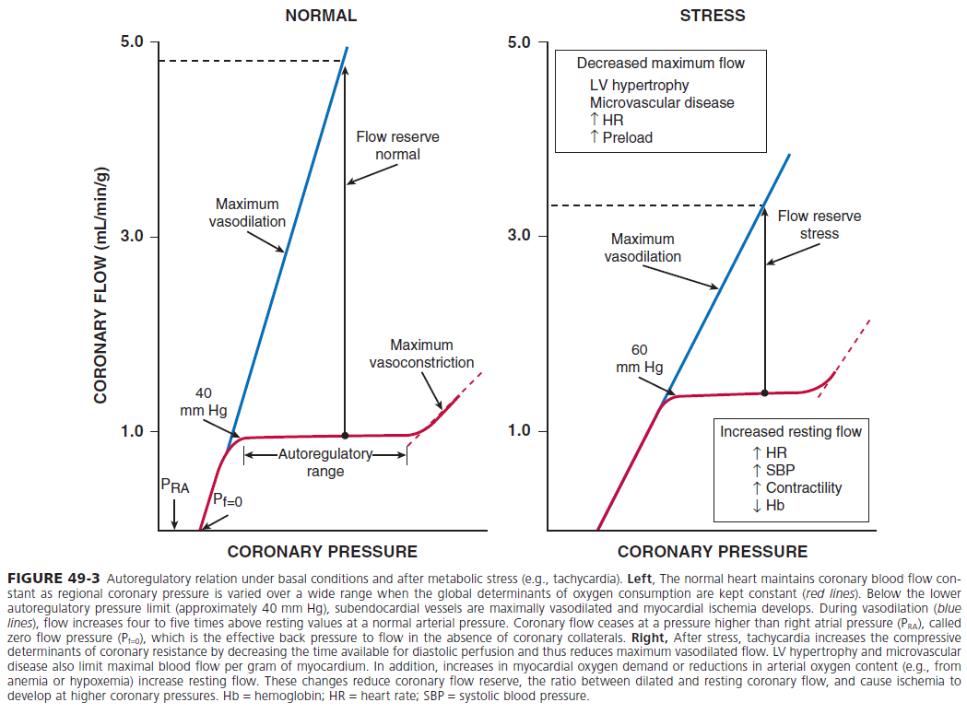
The Coronary blood flow
Oxygen extraction at rest is around 70 %
Increase in oxygen demand
  Is met by increase in coronary blood flow
  Dilation of microcirculation
Coronary blood flow
  At rest is 250ml/min
  Stress upto 5 times

Slide 4
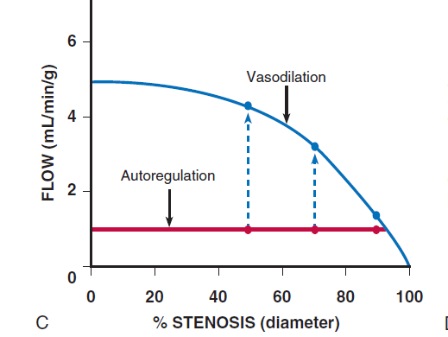
Myocardial ischemia results from…
  Microcirculation dysfunction
  Epicardial stenosis >50
  Coronary angiography
  Fails to detect perfectly 70 %

Slide 5
Limitations (CAG)
Highly subjective
Intermediately severe luminal narrowing (40% -70%) cannot be accurately determined
Identification of normal and diseased vessel segments is complicated by diffuse disease
Artifacts of contrast streaming
Image foreshortening
Overlapping vessels

Slide 6
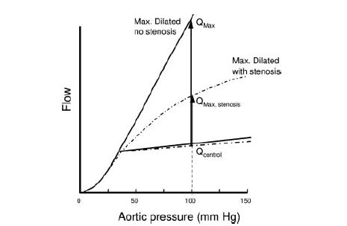
Coronary flow reserve

Slide 7
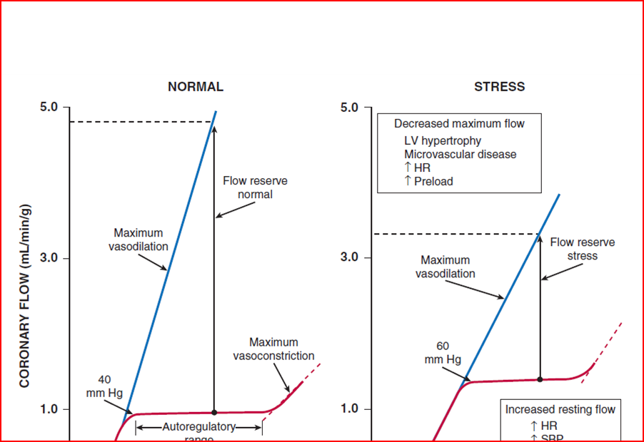
Coronary flow reserve
Normal CFR
  Early studies 3.5 to 5
  CAD Risk factors 2.70
Abnormal CFR
  Microvascular disease.
  Epicardial
ischemic threshold <2.0.

Slide 8
rCFR
Ratio
  maximal flow in a coronary artery with stenosis (QS) to
  maximal flow in a normal coronary artery without a stenosis
Normal range 0.8 to 1.0
Limited role in MVD
Assumes that the microvascular circulatory response is uniformly distributed among the myocardial beds
Is of no value
  In with myocardial infarction
  left ventricular regional dysfunction
  Asymmetric hypertrophy

Slide 9
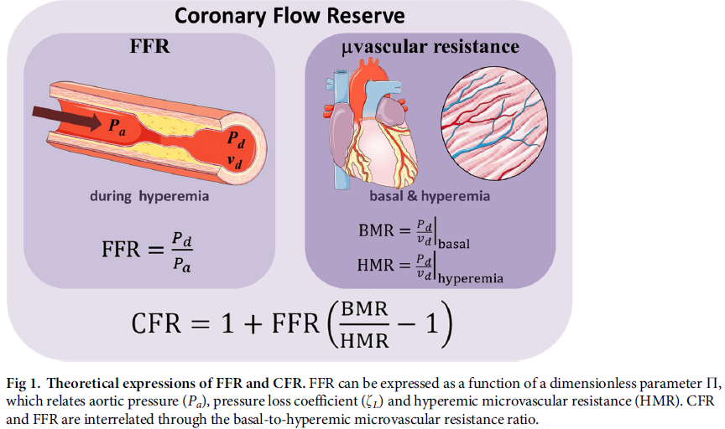

Slide 10
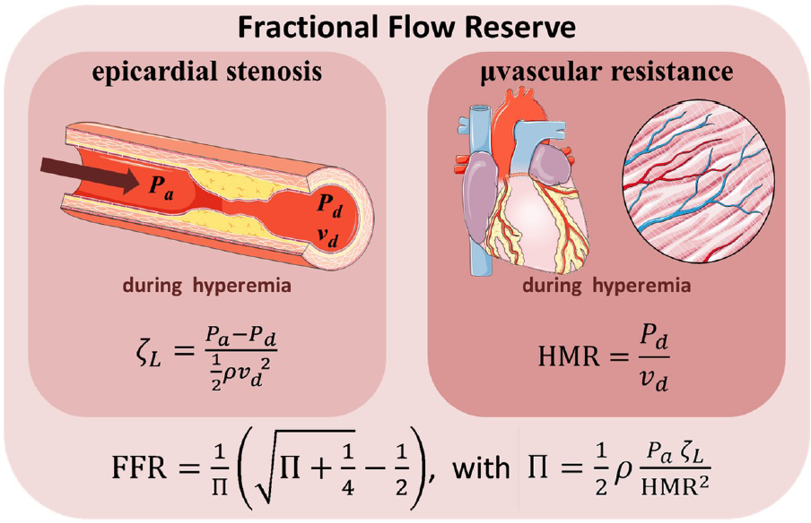

Slide 11
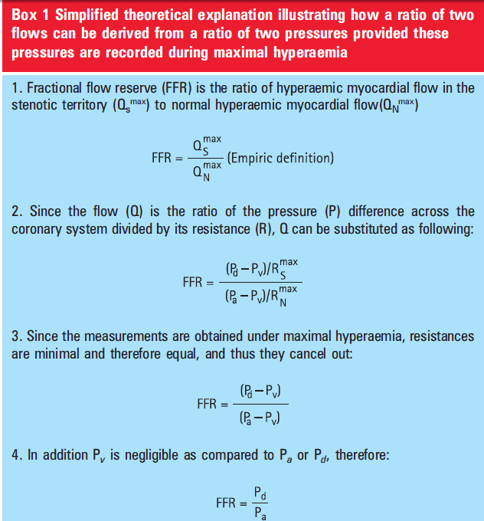

Slide 12
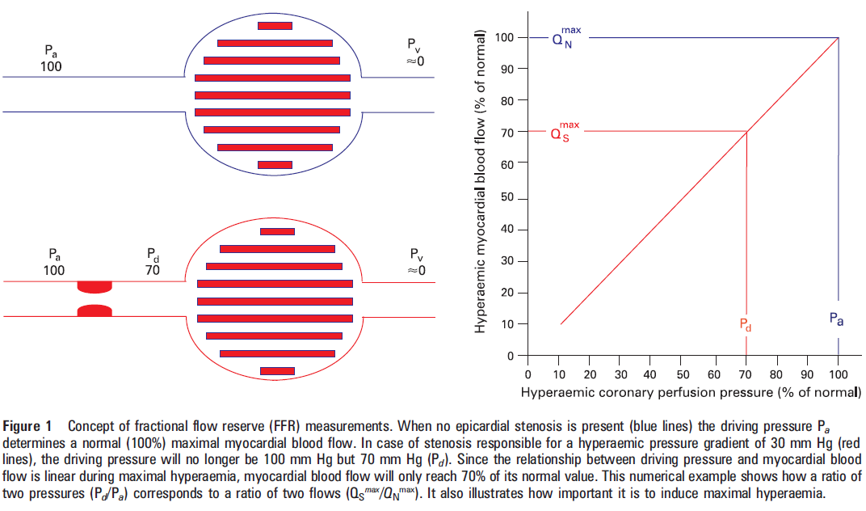

Slide 13
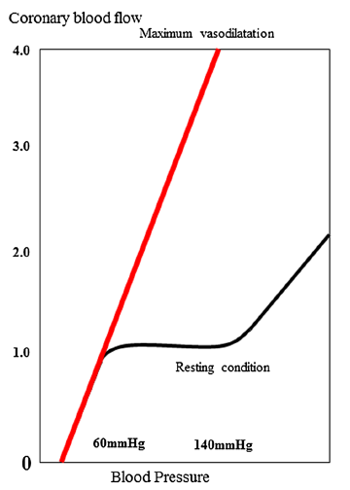

Slide 14
FFR
Normal value 1
An FFR value of 0.6 means the maximum myocardial flow across the stenosis is only 60% of what it should be without the stenosis
An FFR <0.75 is associated with inducible ischemia (specificity, 100%),
An FFR a value >0.80 indicates absence of inducible ischemia in the majority of patients (sensitivity, 90%).

Slide 16
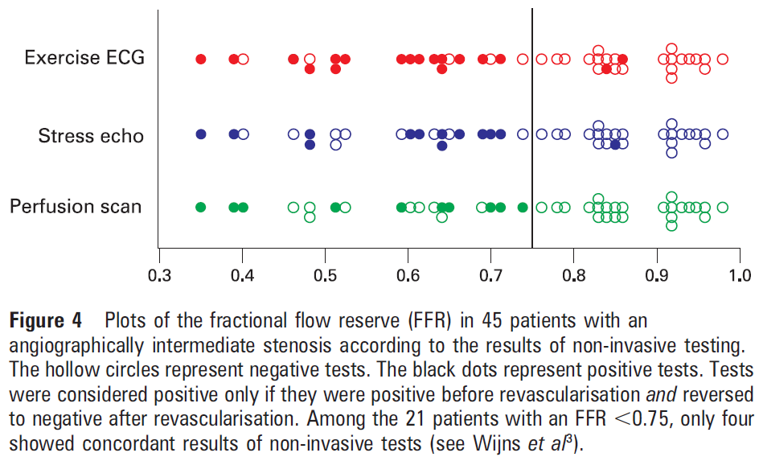

Slide 17
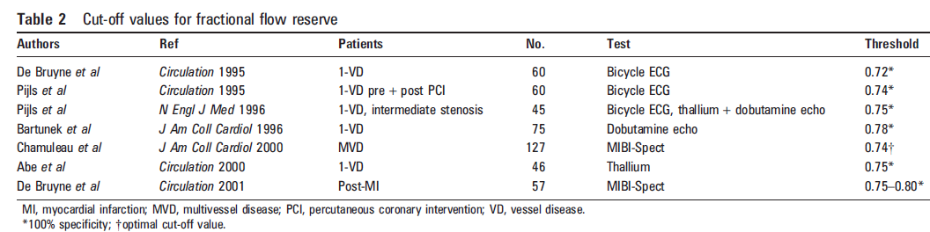

Slide 18
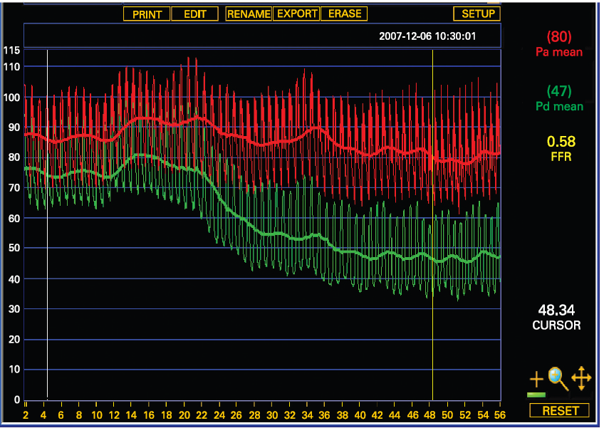
Figure 2 Typical example of simultaneous aortic pressure (Pa) and distal coronary pressure (Pd) recordings at rest and during maximal steady state hyperaemia as induced by an intravenous infusion of adenosine. Soon after starting the infusion, the decrease in distal pressure is preceded by a transient increase in aortic pressure.

Slide 19
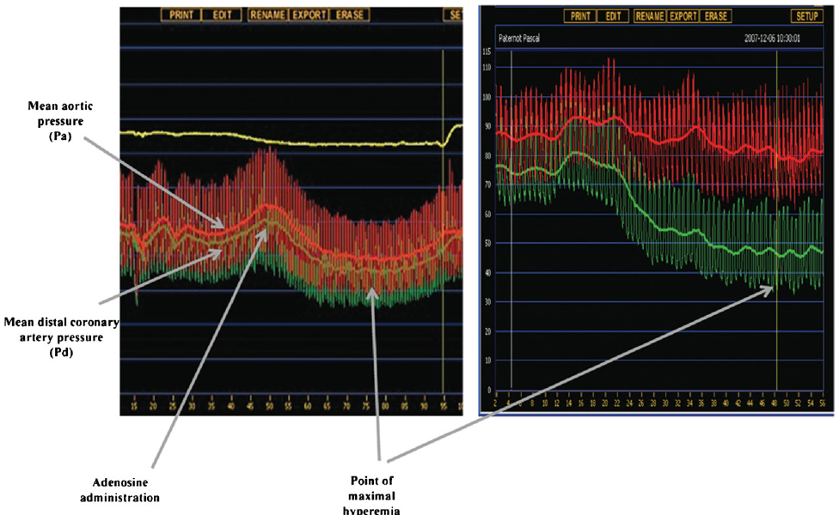

Slide 20
FFR - advantages
Human studies did not show significant changes in FFR with changes in
  heart rate,
  blood pressure,
  contractility.
FFR has a high reproducibility
Low intra-individual variability
FFR, unlike CFR, is independent of
  gender and
  CAD risk factors
It varies less with common doses of adenosine than does CFR

Slide 21
FFR- TECHNIQUE
Catheter
Diagnostic catheters can not be used to measure FFR - pressure measurements can be inaccurate & the wire manipulation is met with friction due to smaller internal diameters compared to guide catheters.
The main advantage of using guide catheters is that PCI is immediately possible if required.
Guide catheter with Side holes should not be used
  It can create a false gradient between the side holes & the tip of the guide catheter creating a false Positive FFR.
  Pharmacological vasodilatory agents may be flushed into the aorta instead of the coronary artery.

Slide 22
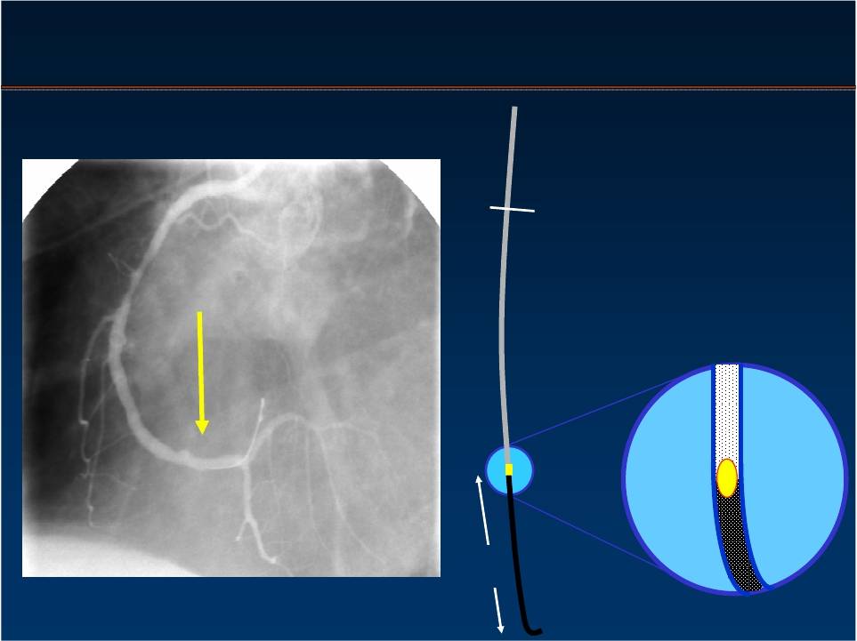
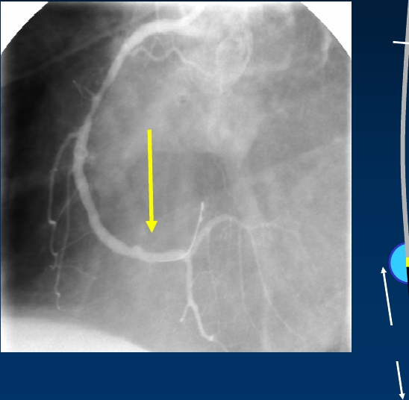

Pressure Monitoring Guide Wire
0.014”
3 cm

Slide 23
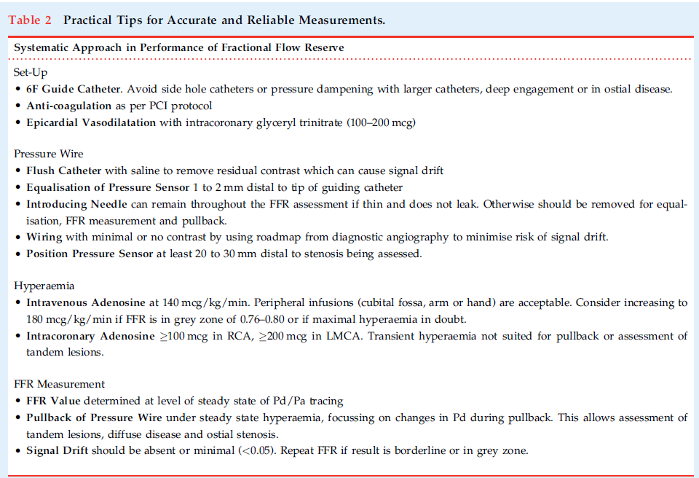

Slide 24
Pressure Measurement
Step 1: Zero the Pressure System to the Atmosphere
Step 2: Insert the Pressure Sensor Guide Wire Into the Guide and Equalize the 2 Pressures
Step 3: Advance the Pressure Wire Sensor Distal to the Region of Interest
Step 4: Induce Maximal Hyperemia
Step 5: Wire Pullback to Check for Signal Drift
Notes:
A standard fluid-filled pressure transducer is used for aortic pressure recordings.
Special attention should be paid to purging the system of air, zeroing of the catheter tubing system, and obtaining an optimal aortic pressure waveform.
The guiding catheter should be frequently flushed with normal saline (at least every 10 minutes). Because contrast medium may subtly dampen the catheter pressure waveform, all contrast medium should be flushed from the catheter during the zeroing steps before pressure measurement.
If any pressure damping or ventricularization of the catheter pressure waveform is observed, the guiding catheter should be gently disengaged from the ostium, taking care not to alter the position of the pressure wire in the distal vessel.
Zero the sensor of the pressure wire ex vivo, following the instructions of the manufacturer.

Slide 25
Key Points of Performance of Fractional Flow Reserve (FFR) Measurements
Patient preparation
• Routinely obtain informed consent for FFR prior to every diagnostic coronary angiogram.
• Medication for FFR identical to PCI.
• Use a large calibre access in the femoral or cubital vein for peripheral adenosine application.
• Beta-blockers do not need to be interrupted.
• Caffeine >1 hour prior to FFR measurement has no clinically-relevant effect.
• Theophylline should be interrupted 12 hours prior to FFR.

Slide 26
Catheter selection and positioning
• Use guiding catheters (at least 5F) without side holes.
• Ascertain coaxial catheter position in the coronary ostium.
• Disengage guiding catheter from ostium for pressure calibration, equalisation and recording of pd/pa if there are doubts about the catheter potentially obstructing the ostium.

Slide 27
Calibration
• Before starting FFR measurement, ensure proper zeroing of the aortic pressure.
• Flush the FFR wire, lay flat when connecting/calibrating and do not move.
• Before equalisation of pressures, advance the FFR wire into the coronary artery until the pressure sensor is positioned precisely at the end of the guide catheter.
• Before equalisation of pressures, flush the guide catheter in order to remove the viscous contrast agent.
• Before equalisation of pressures, remove the introducer and close the haemostatic valve.
• Pressure curves are typically averaged across three-to-five heartbeats. Therefore, pressure equalisation requires some time, and no artefacts should occur during that time

Slide 28
Positioning of the FFR wire or microcatheter
• Pressure sensor should be positioned in the main vessel directly downstream the most distal leasion.
• A second wire, in addition to the pressure sensor, could result in artefacts, and should therefore be avoided.
• Be careful of artefacts: the sensor could interact with the vessel wall, especially in cases of a narrow vessel calibre or severe tortuosity.
• Viscous contrast agent in the coronary artery can affect the gradient pd/pa.
• In the case of a resting gradient <0.80, measurement under hyperaemia is not necessarily required in order to make a clinical decision.

Slide 29
Hyperaemia
• Prior to advancement of the FFR wire/FFR microcatheter, administer intracoronary nitrates in order to prevent spasms in epicardial vessels
• Medication for hyperaemia:
• Intravenous:
Adenosine 140 μg/kg/min
Regadenoson 400 μg undiluted.
• Intracoronary:
Adenosine (e.g. 40 μg intracoronary for the right coronary artery and 80 μg intracoronary for the left coronary artery)
Papaverine (e.g. 8 mg for the right coronary artery and 12 mg for the left coronary artery)
• In the case of measurement results in the borderline area, an increased dose of adenosine is possible (while not supported by evidence). Intravenous doses
>180 μg/kg/min can reduce coronary perfusion, and are therefore, not recommended.

Slide 30
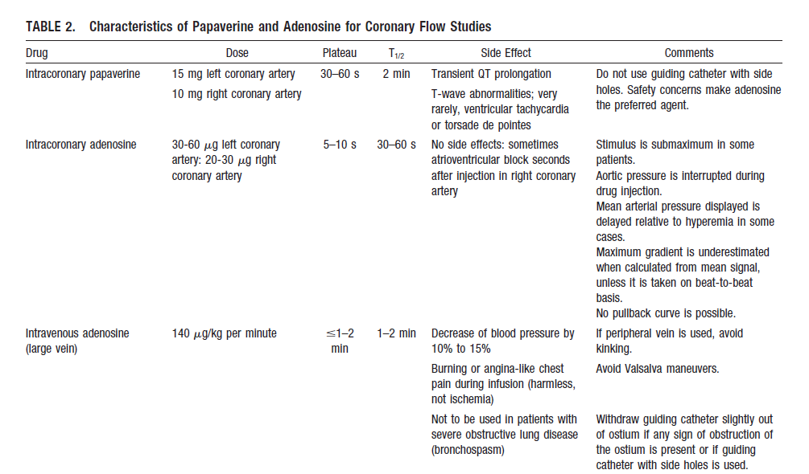

Slide 31
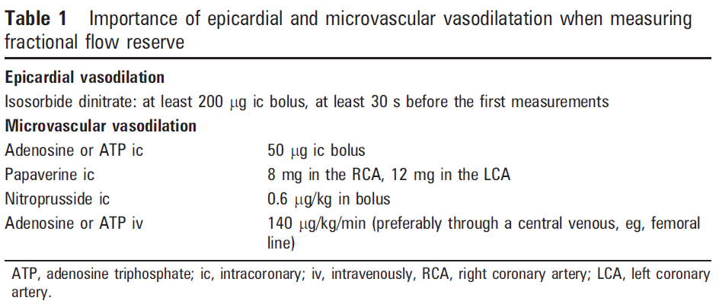

Slide 32
Registration and evaluation
• FFR value is the lowest ratio pd/pa registered during the steady state.
• In case of intravenous adenosine administrations, pressure values can fall to a minimum before reaching a steady state. These values should not be interpreted
as FFR values.
• Artefacts must be carefully observed and excluded.
• Ectopic beats can cause false-low FFR values, which must be excluded.
• Values measured under atrioventricular-block/bradycardia must be classified as “not evaluable”.

Slide 33
Key Points of Special Clinical Situations
Aorto-ostial stenoses
• Intravenous administration of adenosine is preferred.
• Withdraw the guide catheter from the ostium for pressure equalisation and FFR measurement.
Left main coronary artery stenosis
• FFR measurement in downstream vessels without stenosis, optimally both in the left circumflex coronary artery and left anterior descending coronary artery.
Serial stenoses
• Can only be evaluated jointly.
• Distally-measured value represents the combined effect of both lesions.
• Values measured in between two stenoses are unreliable.

Slide 34
Acute coronary syndromes
• In the case of STEMI, FFR measurement in the infarcted vessel is neither reasonable nor possible. In the case of NSTEMI, in the absence of a relevant thrombus load, lesions can be assessed using FFR.
FFR during and after PCI
• There is no established target value for FFR after PCI.
• In the case of bifurcation lesion PCI, revascularisation of the side branch is not necessary if FFR is >0.80 in the side branch

Slide 35
Limitations of Fractional Flow Reserve
Measurements
Microvascular dysfunction,
previous myocardial infarction
Left ventricular hypertrophy
diabetic microangiopathy

Slide 36
certain patient groups were not included or tested in the randomised FFR studies.
FAME studies, (excluded)
left main coronary artery stenosis,
recent history of STEMI
history of bypass surgery
impaired left ventricular (LV) systolic function (LV ejection fraction <30 %)
left ventricular hypertrophy (>13 mm)
there are currently no randomised, controlled outcome studies to validate FFR.

Slide 37
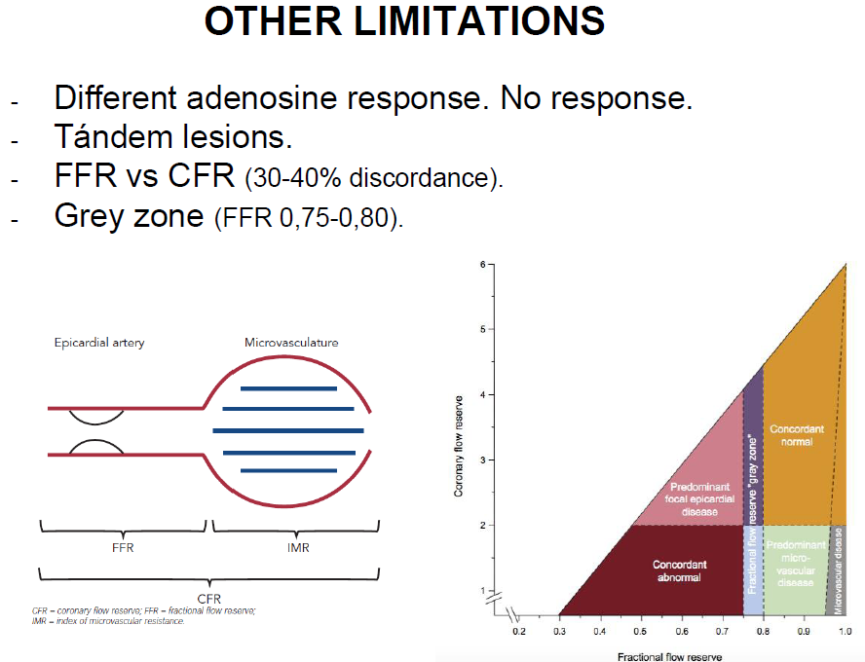

Slide 38
Instantaneous wave-free ratio (iFR)
reduce the procedural time, improve cost efficiencies as well as improve patient comfort
iFR is founded on the basis that there is a certain period in each cardiac cycle during which resistance at rest is stable (the wave-free period).
During this phase the ratio of the proximal and distal pressures are proportional to coronary flow

Slide 39
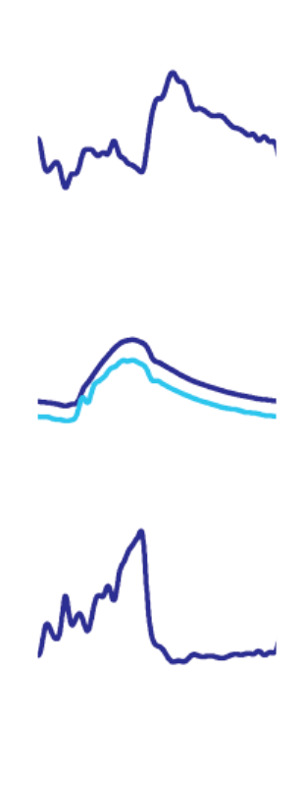
Identification of wave-free period
Wave-free period
Fully automated algorithms
Identification of naturally low resistance period
Uses pressure only
Wave-free period
Sen S, Escaned J, Davies JE et al. JACC (in press 2011)
Davies JE et al. Circulation 2006;113:1767-1778
Davies JE et al. Circulation 2011;124:1565-1572
Notes:
Radical solution, be identification of the wave-free period.

Slide 40
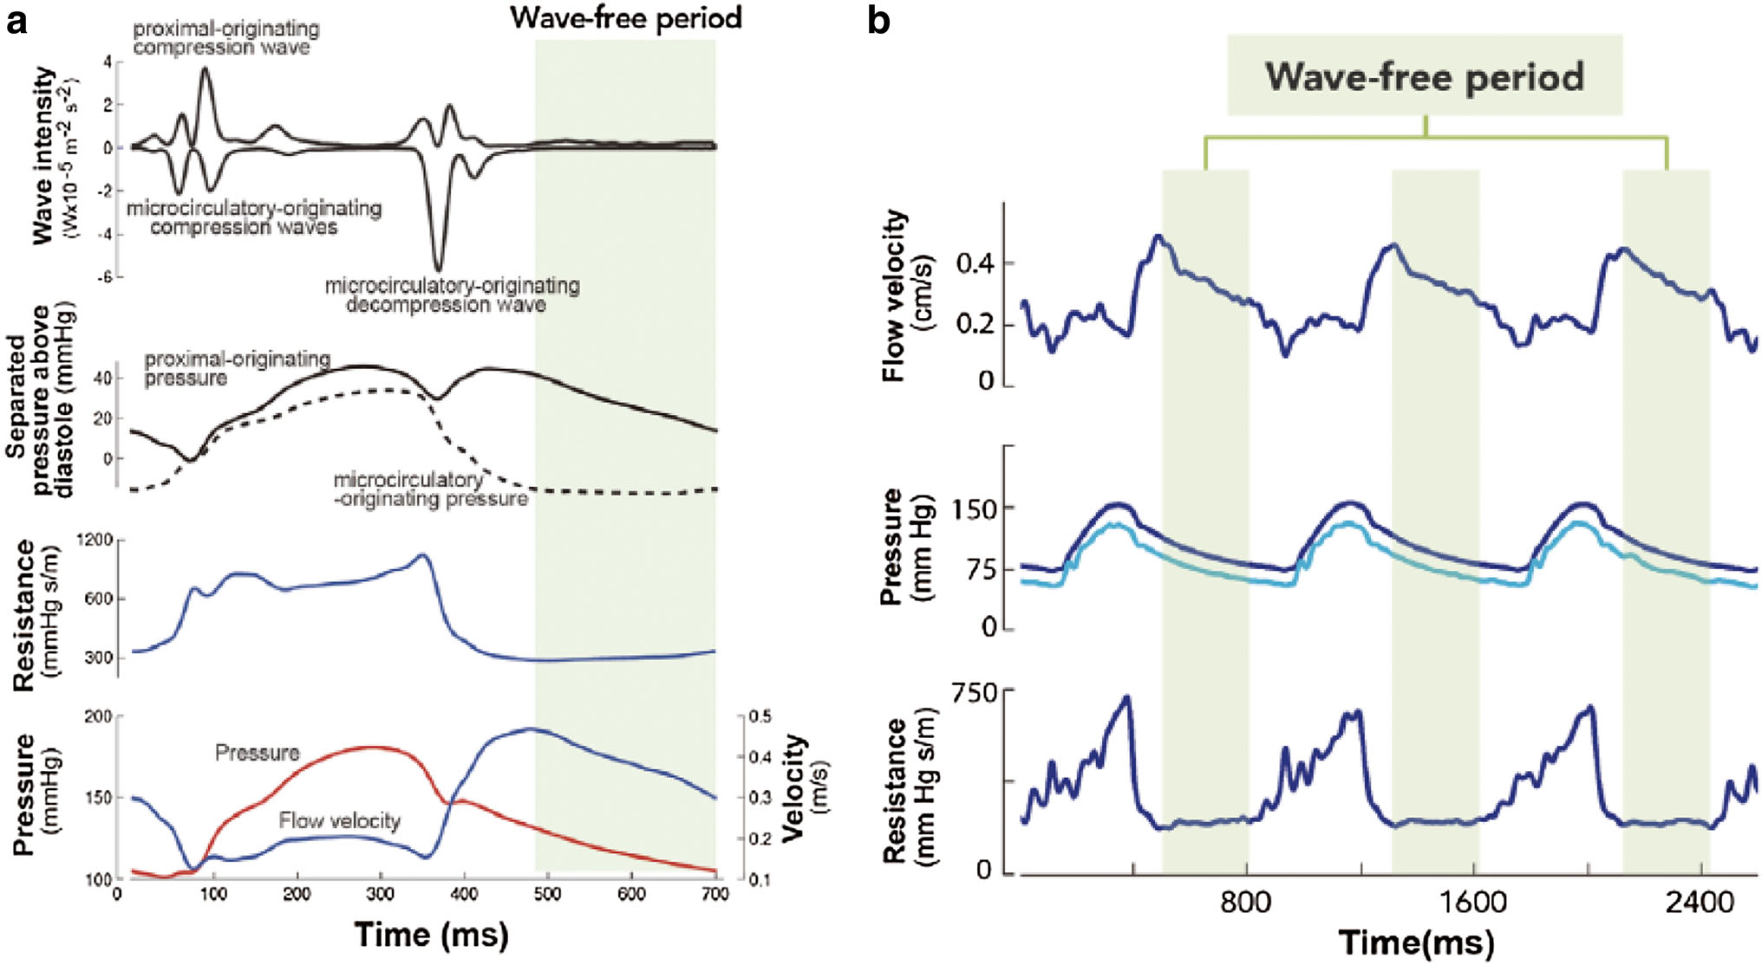

Slide 41
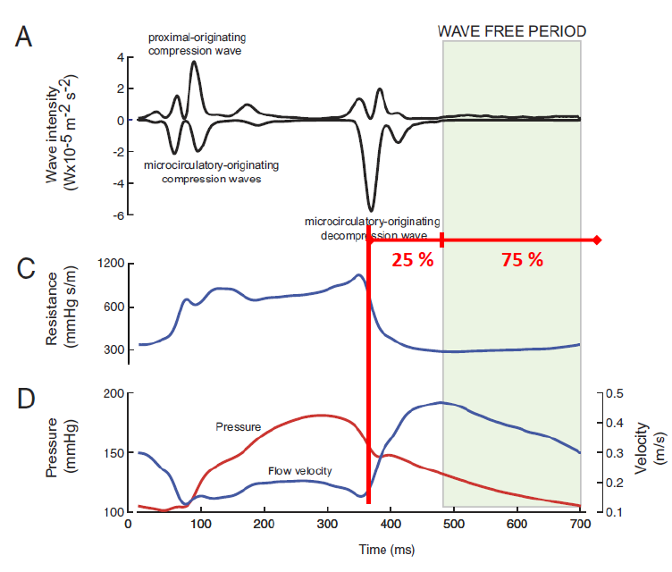
Instantaneouswave-free ratio (iFR)

Slide 42
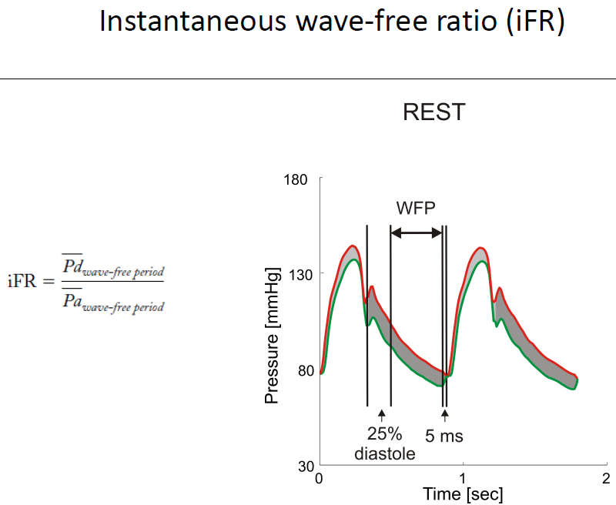

Slide 43
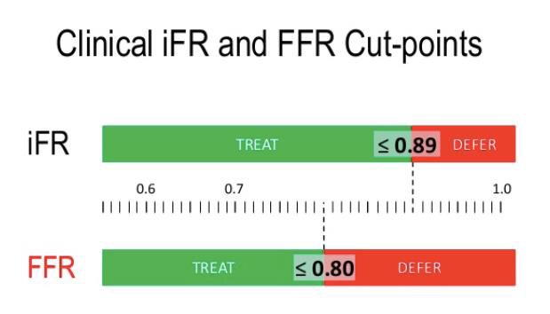

80 - 85% concordance between iFR and FFR when iFR = 0.89

Slide 44
trials

Slide 45
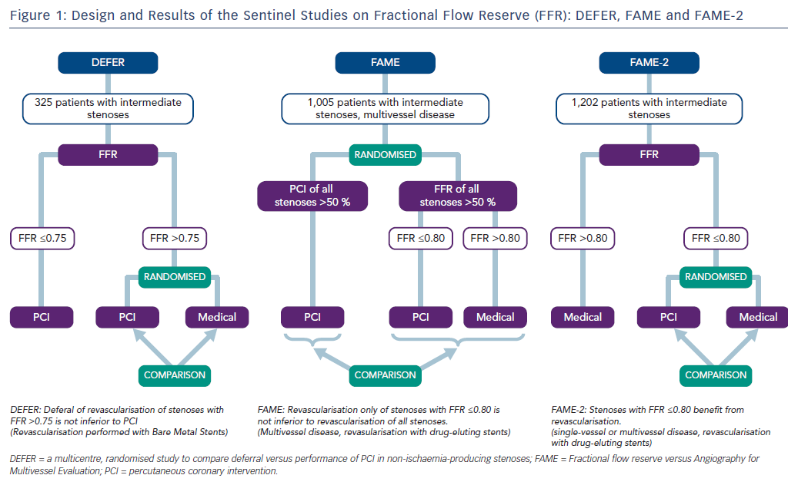

Slide 46
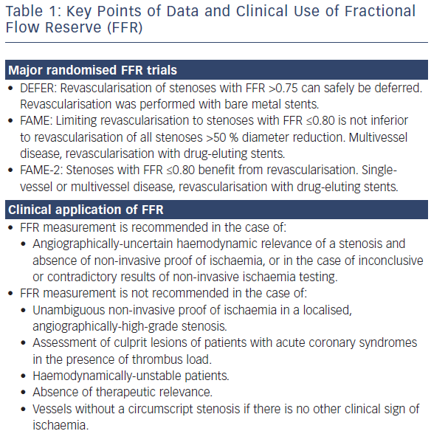

Slide 47
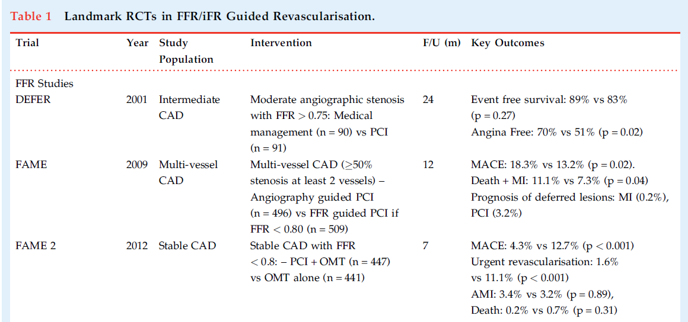

Slide 48
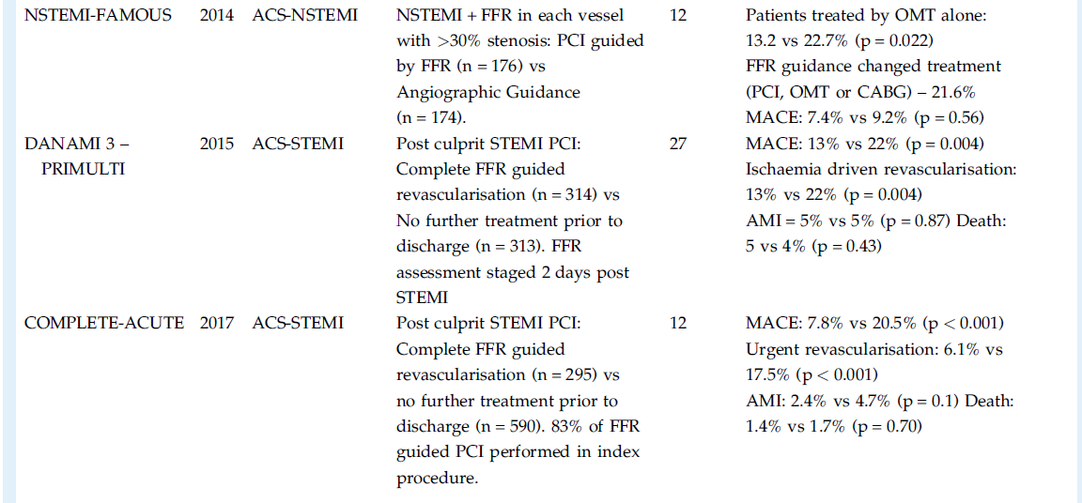

Slide 49
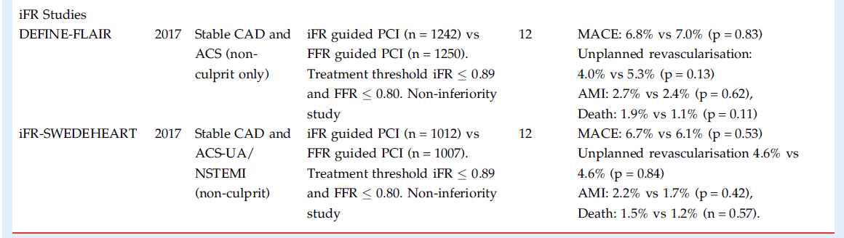

Slide 50
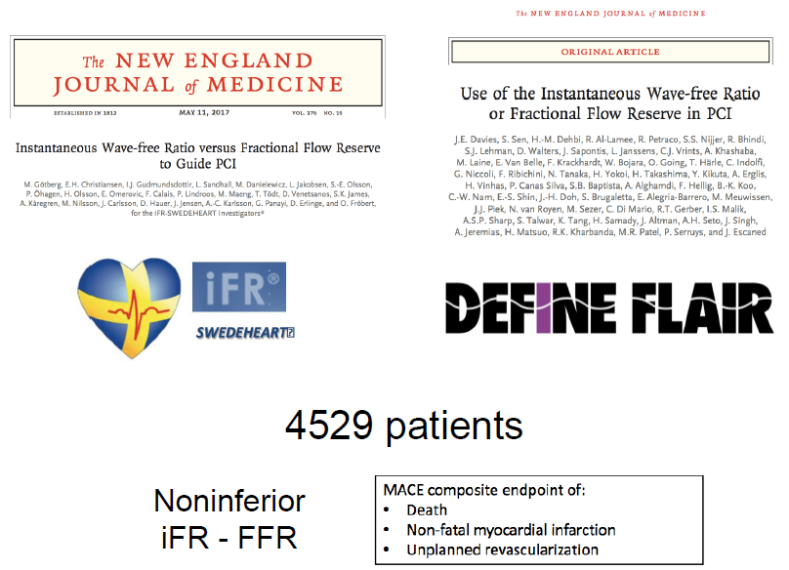

Slide 51
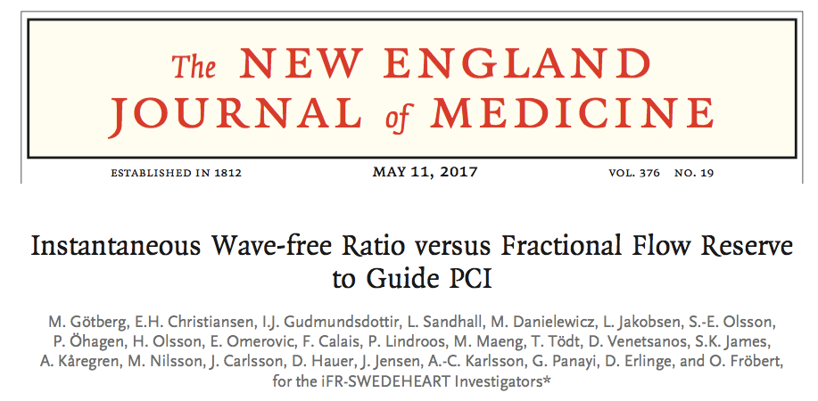
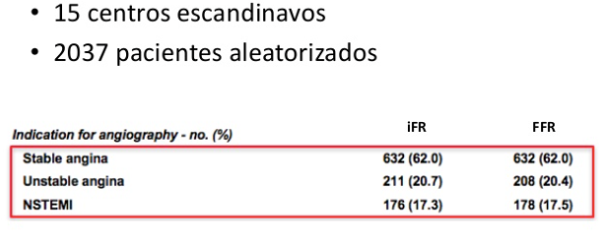


Slide 52
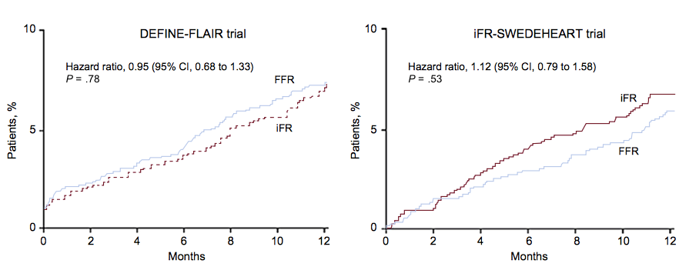
iFR was non inferior to FFR
with respect MACE at 12 months
(dead, non fatal MI, unplanned revascularization)

Slide 53
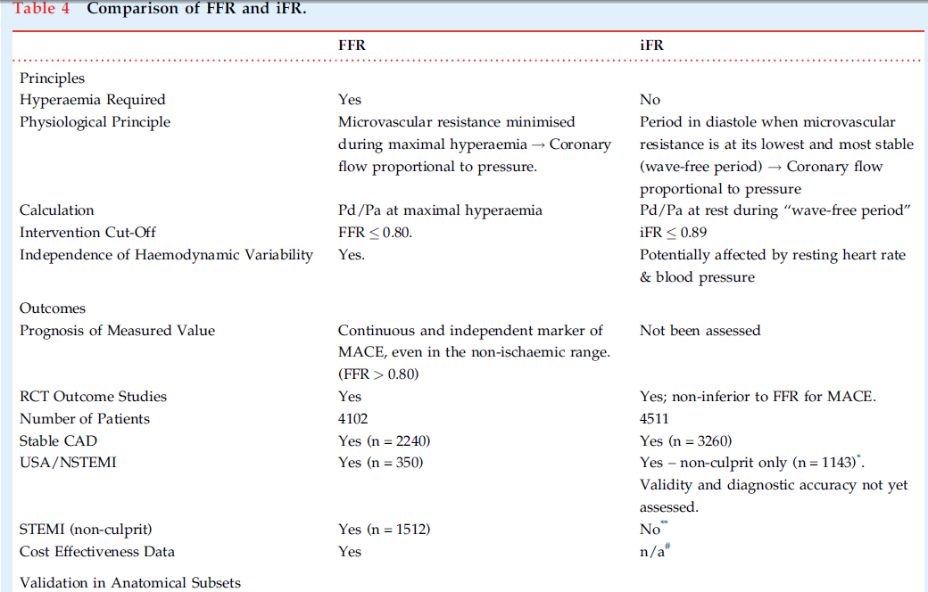
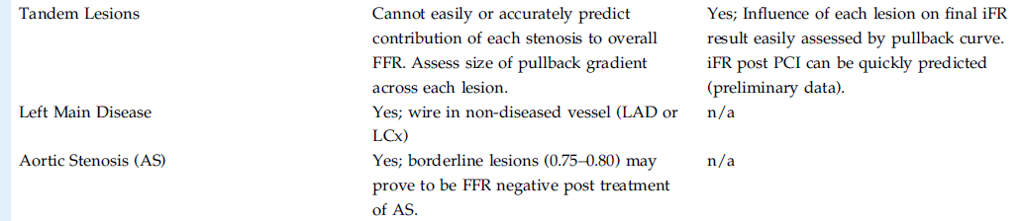

Slide 54
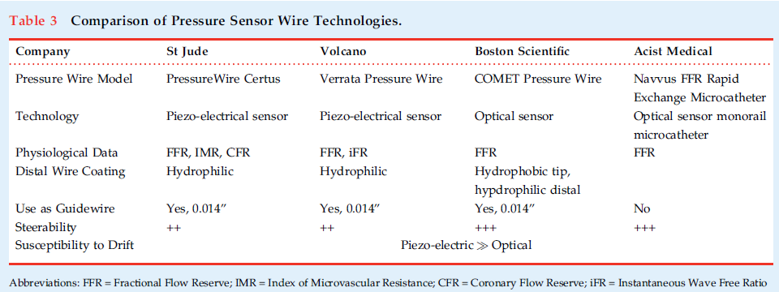

Slide 55
Thank you

Slide 56
Back up slides

Slide 57
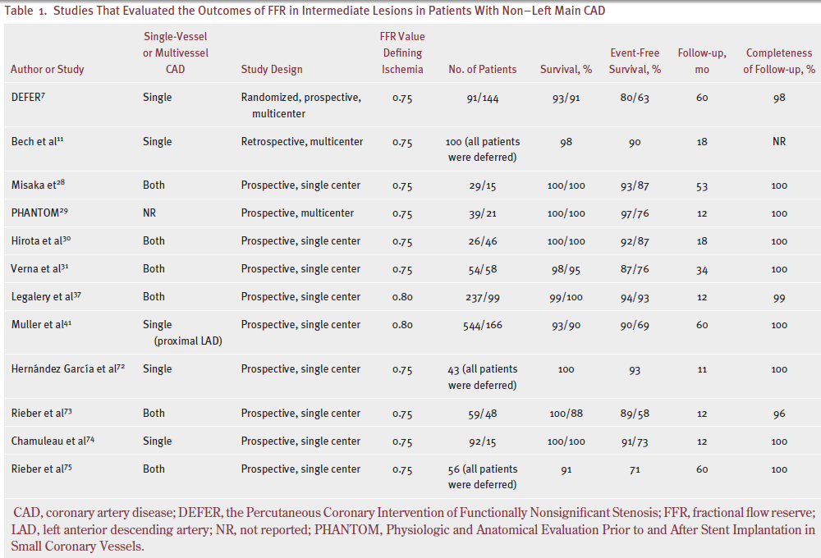

Slide 58
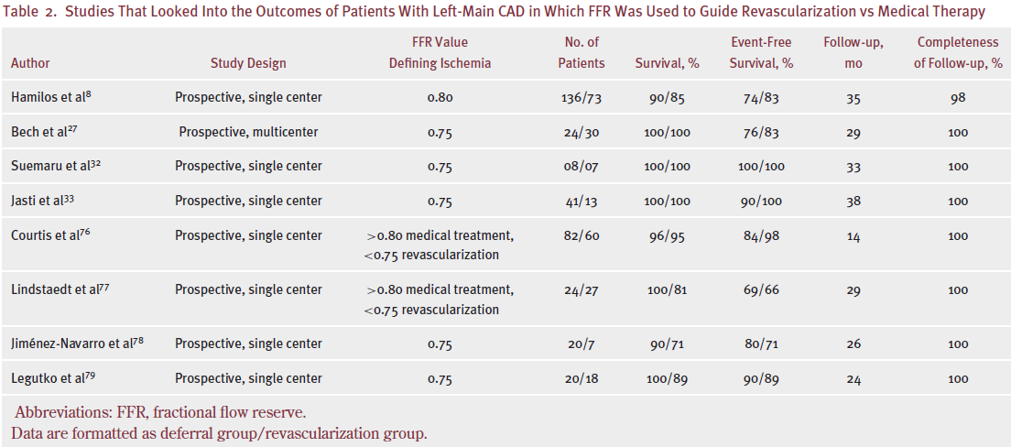

Slide 59
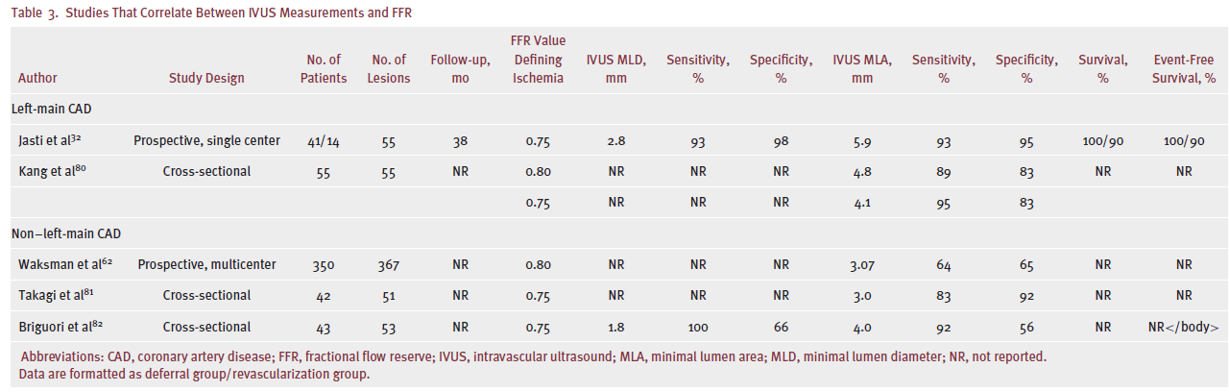
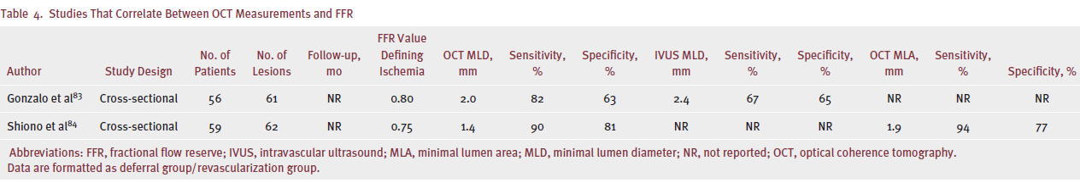

Slide 60
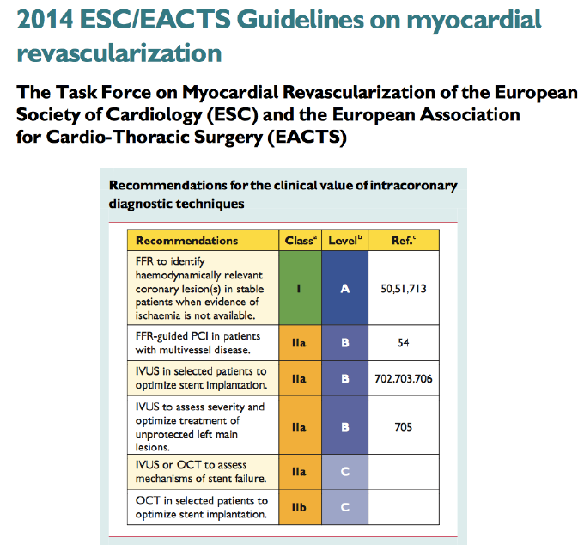

Slide 61
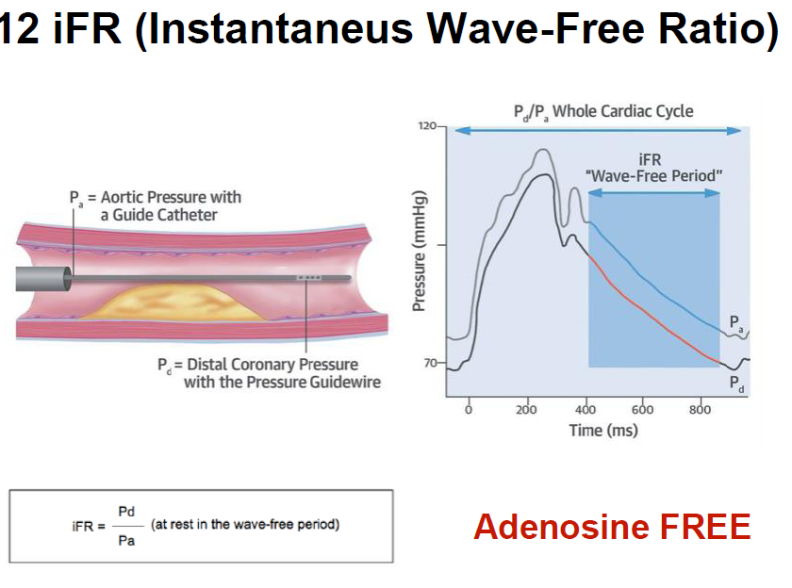

Slide 62
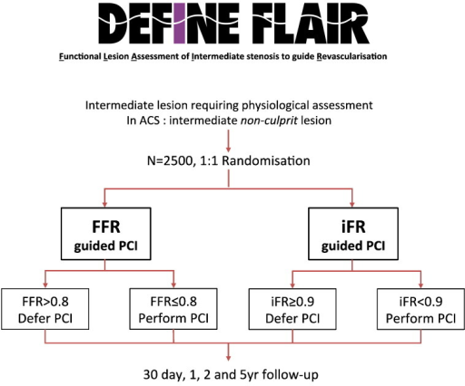
49 centers
19 countries

Slide 63

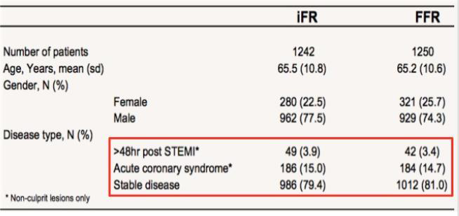

Slide 64
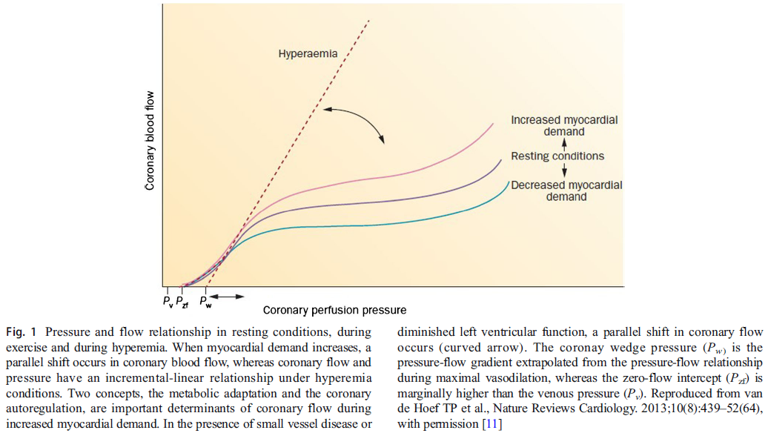

Slide 65
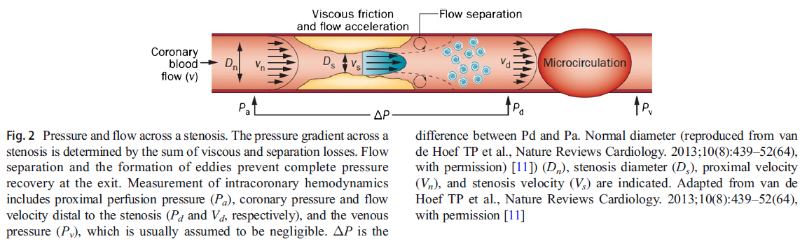

Slide 66
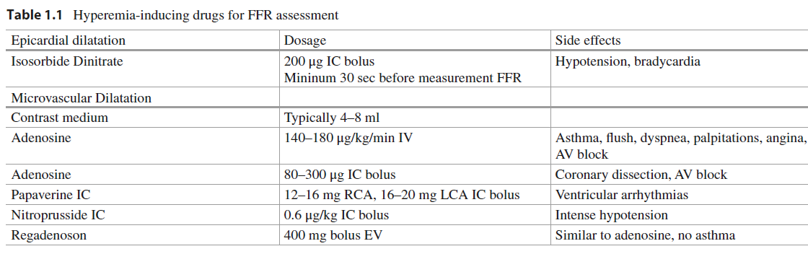

Slide 67
